Slide 1
Chapter 1 An Overview of Computer and Microprocessor

Slide 2
Google Classroom
Class Name: MPCA
Class code: zqib5ai

Slide 3
Google Classroom
Class Name: NLP
Class code: wadp552

Slide 4
Overview: 2 hrs
Brief overview of Microprocessor and Microcontroller
Organization of Computer systems
Architecture of Computer
Applications of Microprocessor and Microcontroller

Slide 5
Brief overview of Microprocessor and Microcontroller

Slide 6
Differences between:
Microcomputer – a computer with a microprocessor as its CPU. Includes memory, I/O etc.
Microprocessor – silicon chip which includes ALU, register circuits & control circuits
Microcontroller – silicon chip which includes microprocessor, memory & I/O in a single package.

Slide 7
Microprocessor
The word comes from the combination micro and processor.
Processor means a device that processes whatever. In this context processor means a device that processes numbers, specifically binary numbers, 0’s and 1’s.
To process means to manipulate. It is a general term that describes all manipulation. Again in this content, it means to perform certain operations on the numbers that depend on the microprocessor’s design.

Slide 8
Definition of the Microprocessor
The microprocessor is a programmable device that
takes in numbers,
performs on them arithmetic or logical operations according to the program stored in memory
and then produces other numbers as a result.

Slide 9
Takes in: The data that the microprocessor manipulates must come from somewhere.
It comes from what is called “input devices”.
These are devices that bring data into the system from the outside world.
These represent devices such as a keyboard, a mouse, switches, and the like.

Slide 10
– Numbers: The microprocessor has a very narrow view on life. It only understands binary numbers.
A binary digit is called a bit (which comes from binary digit).
The microprocessor recognizes and processes a group of bits together. This group of bits is called a “word”.
The number of bits in a Microprocessor’s word, is a measure of its “abilities”.

Slide 11
Words, Bytes, etc.
The earliest microprocessor (the Intel 8088 and Motorola’s 6800) recognized 8-bit words.
They processed information 8-bits at a time. That’s why they are called “8-bit processors”. They can handle large numbers, but in order to process these numbers, they broke them into 8-bit pieces and processed each group of 8-bits separately.
Later microprocessors (8086 and 68000) were designed with 16-bit words.
A group of 8-bits were referred to as a “half-word” or “byte”.
A group of 4 bits is called a “nibble”.
Also, 32 bit groups were given the name “long word”.
Today, all processors manipulate at least 32 bits at a time and there exists microprocessors that can process 64, 80, 128 bits

Slide 12
Arithmetic and Logic Operations:
Every microprocessor has arithmetic operations such as add and subtract as part of its instruction set.
Most microprocessors will have operations such as multiply and divide.
Some of the newer ones will have complex operations such as square root.
In addition, microprocessors have logic operations as well. Such as AND, OR, XOR, shift left, shift right, etc.
Again, the number and types of operations define the microprocessor’s instruction set and depends on the specific microprocessor.

Slide 13
Stored in memory :
First, what is memory?
Memory is the location where information is kept while not in current use.
Memory is a collection of storage devices. Usually, each storage device holds one bit. Also, in most kinds of memory, these storage devices are grouped into groups of 8. These 8 storage locations can only be accessed together. So, one can only read or write in terms of bytes to and form memory.
Memory is usually measured by the number of bytes it can hold.
It is measured in Kilos, Megas and lately Gigas. A Kilo in computer language is 2¹⁰ =1024. So, a KB (KiloByte) is 1024 bytes. Mega is 1024 Kilos and Giga is 1024 Mega.

Slide 14
Stored in memory:
When a program is entered into a computer, it is stored in memory. Then as the microprocessor starts to execute the instructions, it brings the instructions from memory one at a time.
Memory is also used to hold the data.
– The microprocessor reads (brings in) the data from memory when it needs it and writes (stores) the results into memory when it is done.

Slide 15
Produces: For the user to see the result of the execution of the program, the results must be presented in a human readable form.
The results must be presented on an output device.
This can be the monitor, a paper from the printer, a simple LED or many other forms.

Slide 16
A Microprocessor-based system
From the above description, we can draw the following block diagram to represent a microprocessor-based system:
Input
Output
Memory

Slide 17
Inside The Microprocessor
Internally, the microprocessor is made up of 3 main units.
The Arithmetic/Logic Unit (ALU)
The Control Unit.
An array of registers for holding data while it is being manipulated.

Slide 18
Organization of a microprocessor- based system
Let’s expand the picture a bit.
I/O Input / Output
ALU | Register Array
Control
System Bus
Memory
ROM RAM

Slide 19
Memory
I/O Input / Output
ALU | Register Array
Control
Memory stores information such as instructions and data in binary format (0 and 1).
It provides this information to the microprocessor whenever it is needed.
Usually, there is a memory “sub-system” in a microprocessor-based system. This sub-system includes:
The registers inside the microprocessor
Read Only Memory (ROM)
used to store information that does not change.
Random Access Memory (RAM) (also known as Read/Write Memory).
used to store information supplied by the user. Such as programs and data.
System Bus
Memory
ROM RAM
To execute a program:
the user enters its instructions in binary format into the memory.
The microprocessor then reads these instructions and whatever data is needed from memory, executes the instructions and places the results either in memory or produces it on an output device.

Slide 20
Memory Map and Addresses
The memory map is a picture representation of the address range and shows where the different memory chips are located within the address range.
EPROM
RAM 1
RAM 2
RAM 3
RAM 4
Address Range of EPROM Chip
3FFF
4400
Address Range of 1st RAM Chip
5FFF
6000
Address Range of 2nd RAM Chip
Address Range
8FFF
9000
A3FF A400
Address Range of 3rd RAM Chip
Address Range of 4th RAM Chip
F7FF
FFFF

Slide 21
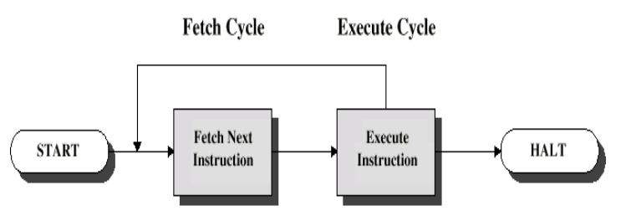
The three cycle instruction execution model
To execute a program, the microprocessor “reads” each instruction from memory, “interprets” it, then “executes” it.
To use the right names for the cycles:
The microprocessor fetches each instruction,
decodes it,
Then executes it.
This sequence is continued until all instructions are performed.

Slide 22
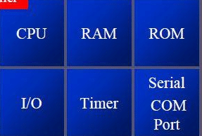
Microcontroller
A microcontroller is a chip optimized to control electronic devices.
It is stored in a single integrated circuit which is dedicated to performing a particular task and execute one specific application.
It is specially designed circuits for embedded applications and is widely used in automatically controlled electronic devices.
It contains memory, processor, and programmable I/O.
Eg: 8051 Microcontroller

Slide 23
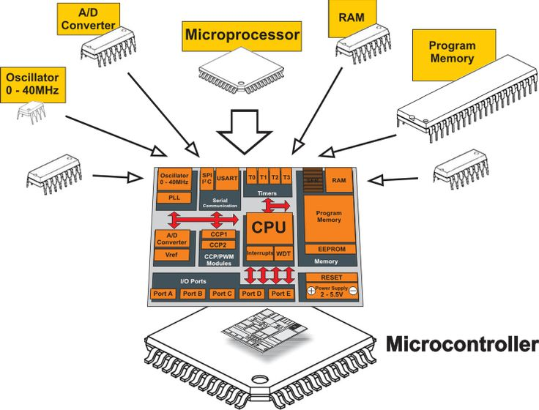

Slide 24
Applications of Microprocessor and Microcontroller

Slide 25
Application of Microprocessor
Computers: Microprocessors form the core of computers, including personal computers, laptops, and servers. They handle tasks like executing instructions, managing memory, and controlling input/output devices.
Embedded Systems: Microprocessors are extensively used in embedded systems, which are specialized computer systems designed for specific applications. They can be found in appliances, automotive systems, industrial control systems, and consumer electronics.
Communication Systems: Microprocessors are used in communication systems like routers, modems, and network switches. They handle data transmission, network protocols, and routing algorithms.
Automotive Industry: Microprocessors play a vital role in modern vehicles. They control functions such as engine management, fuel injection systems, anti-lock braking systems (ABS), airbag control, entertainment systems, and navigation systems.
Robotics: Microprocessors are used for controlling the movements and operations of robots. They process sensor data, execute control algorithms, and enable autonomous decision-making.

Slide 26
Application of Microprocessor
Aerospace and Defense: Microprocessors are essential components in aerospace and defense systems, including aircraft flight controls, missile guidance systems, satellite communications, and radar systems.
Consumer Electronics: Microprocessors are widely used in consumer electronics products like smart TVs, gaming consoles, digital cameras, audio systems, and wearable devices. They provide the necessary processing power for multimedia applications and user interfaces.
Internet of Things (IoT): Microprocessors play a key role in IoT devices, enabling connectivity, data processing, and control in applications such as smart homes, industrial automation, agriculture monitoring, and environmental sensing.
Medical Devices: Microprocessors are utilized in medical equipment and devices, including patient monitoring systems, imaging devices (e.g., MRI and CT scanners), implantable devices, and laboratory equipment. They enable data processing, control, and real-time analysis.
Industrial Control Systems: Microprocessors are employed in industrial automation and control systems to monitor and control manufacturing processes, robotics, assembly lines, and supervisory control and data acquisition (SCADA) systems.

Slide 27
Application of Microcontroller
Home Automation: Microcontrollers are used to control and automate various functions in smart homes, including lighting systems, temperature control, security systems, and appliances.
Internet of Things (IoT): Microcontrollers play a crucial role in IoT devices by providing connectivity, data processing, and control capabilities. They are used in applications such as environmental monitoring, smart agriculture, and industrial automation.
Automotive Systems: Microcontrollers are extensively used in automotive applications, including engine control units (ECUs), anti-lock braking systems (ABS), airbag control, dashboard displays, and entertainment systems.
Consumer Electronics: Microcontrollers are found in a wide range of consumer electronics, such as remote controls, digital cameras, home entertainment systems, and wearable devices. They provide control and interface functionality.
Medical Devices: Microcontrollers are used in various medical devices, including patient monitoring systems, insulin pumps, prosthetic devices, and diagnostic equipment. They enable data processing, control, and communication functions.

Slide 28
Application of Microcontroller
Industrial Automation: Microcontrollers are used in industrial control systems to monitor and control processes, machinery, and equipment. They play a key role in programmable logic controllers (PLCs), robotics, and supervisory control and data acquisition (SCADA) systems.
Robotics: Microcontrollers are crucial for controlling the movements, sensors, and actuators of robots. They handle real-time data processing, control algorithms, and communication interfaces.
Security Systems: Microcontrollers are employed in security systems such as access control systems, alarm systems, and surveillance systems. They provide the necessary processing power and interfaces for monitoring and controlling security functions.
Energy Management: Microcontrollers are used in energy management systems for monitoring and controlling power consumption, renewable energy systems, and smart grid applications.
Educational Tools: Microcontrollers are widely used in educational settings for teaching and learning purposes. They provide a hands-on platform for students to learn about programming, electronics, and control systems.

Slide 29
Assignment:
Differentiate between Microprocessor and Microcontroller

Slide 30
3. Architecture of Computer

Slide 31
Computer Architecture
Computer architecture comprises rules, methods, and procedures that describe the execution and functionality of the entire computer system.
In general terms, computer architecture refers to how a computer system is designed using compatible technologies.

Slide 32
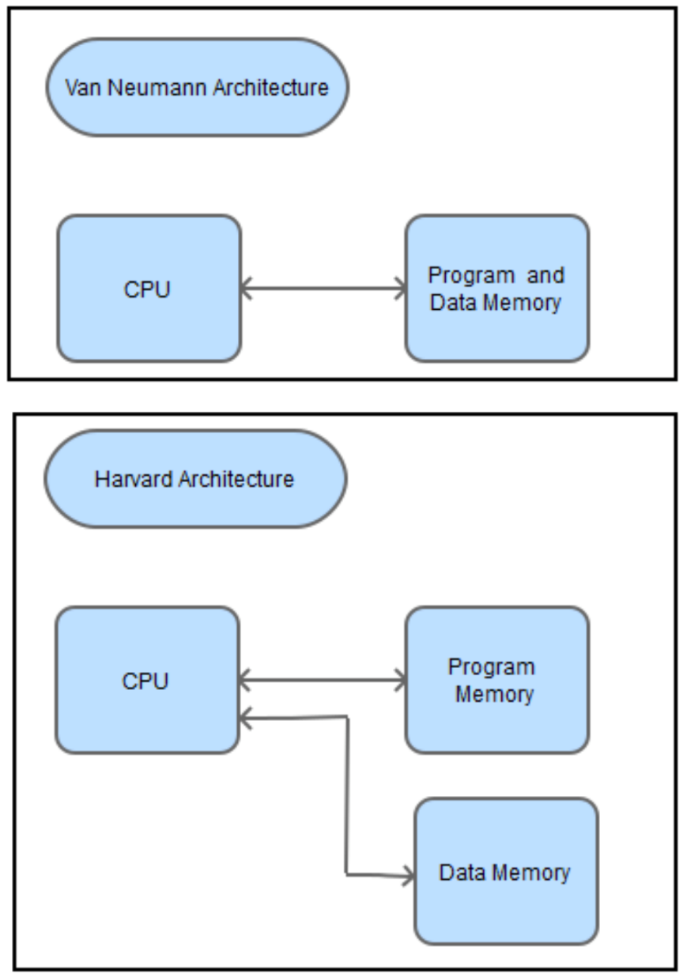
Types of Computer Architecture
Von-Neumann Architecture
Harvard Architecture

Slide 33
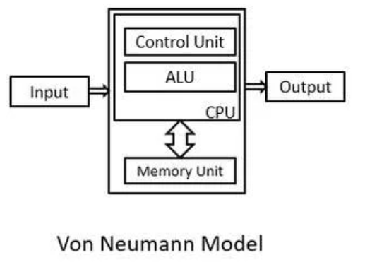
Von Neuman Architecture
The Von Neumann architecture is a type of computer architecture in which the central processing unit (CPU), memory, and input/output (I/O) devices all use a single shared bus for communication.
It was named after John von Neumann, a pioneer in the development of electronic computers. The Von Neumann architecture is also known as the Von Neumann model or the Princeton architecture.
In a Von Neumann architecture, instructions and data are stored in a single memory system. This memory is usually implemented as random access memory (RAM) and is connected to the CPU and I/O devices through a common bus. The CPU executes instructions by fetching them from memory, decoding them, and then executing them.

Slide 34
Von Neuman Architecture
The Von Neumann architecture consists of four main components:
CPU: The central processing unit is the brain of the computer. It performs all the calculations and operations required to execute instructions.
Memory: The memory holds both instructions and data that the CPU needs to execute. The memory is organized as a linear sequence of addressable cells, each containing a fixed number of bits.
Input/output (I/O) devices: These devices are used to communicate with the outside world. Examples include keyboards, displays, and printers.
System bus: The system bus is a collection of wires that connect the CPU, memory, and I/O devices. It is used to transmit data, instructions, and control signals between these components.

Slide 35
Advantages / Disadvantages of Von-Neumann Architecture
Simple and flexible
Less physical space is required than Harvard
Handling just one memory block is simpler and easier to achieve
Cheaper to use than Harvard
Shared memory - a defective program can overwrite another in memory, causing it to crash
Memory leaks - some defective programs fail to release memory when they are finished with it, which could cause the computer to crash due to insufficient memory
Data bus speed - the CPU is much faster than the data bus, meaning it often sits idle (Von Neumann bottleneck)
Fetch rate - data and instructions share the same data bus, even though the rate at which each needs to be fetched is often very different

Slide 36
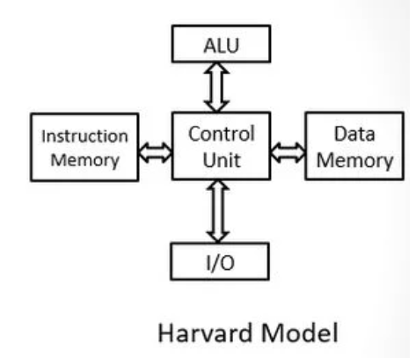
Harvard Architecture
Harvard architecture is a type of computer architecture that has separate memory spaces for instructions and data.
It was developed at Harvard University in the 1930s, and it is named after this institution.
In a Harvard architecture system, the CPU accesses instruction and data memory spaces separately, which can lead to improved performance.

Slide 37
Harvard Architecture
The Harvard architecture consists of the following main components:
CPU: The central processing unit performs all the calculations and operations required to execute instructions.
Instruction memory: This memory holds instructions that the CPU needs to execute. It is typically implemented as read-only memory (ROM) or flash memory.
Data memory: This memory holds data that the CPU needs to perform computations. It is typically implemented as random access memory (RAM).
Input/output (I/O) devices: These devices are used to communicate with the outside world. Examples include keyboards, displays, and printers.
System bus: The system bus is a collection of wires that connect the CPU, instruction memory, data memory, and I/O devices. It is used to transmit data, instructions, and control signals between these components.

Slide 38
Advantages / Disadvantages of Harvard Architecture
Fast and efficient data access: Since Harvard architecture has separate memory spaces for instructions and data, it allows for parallel and simultaneous access to both memory spaces, which leads to faster and more efficient data access.
Better performance: The use of fixed instruction length, parallel processing, and optimized memory usage in Harvard architecture can lead to improved performance and faster execution of instructions.
Suitable for real-time applications: Harvard architecture is commonly used in embedded systems and other real-time applications where speed and efficiency are critical.
Security: The separation of instruction and data memory spaces can also provide a degree of security against certain types of attacks, such as buffer overflow attacks.
Complexity: The use of separate memory spaces for instructions and data in Harvard architecture adds to the complexity of the processor design and can increase the cost of manufacturing.
Limited flexibility: Harvard architecture has limited flexibility in terms of modifying instructions at runtime because instructions and data are stored in separate memory spaces. This can make certain types of programming more difficult or impossible to implement.
Higher memory requirements: Harvard architecture requires more memory than Von Neumann architecture, which can lead to higher costs and power consumption.
Code size limitations: Fixed instruction length in Harvard architecture can limit the size of code that can be executed, making it unsuitable for some applications with larger code bases.

Slide 39
Assignment:
Differentiate between Von Neumann and Harvard architectures

Slide 40
2. Organization of Computer systems

Slide 41
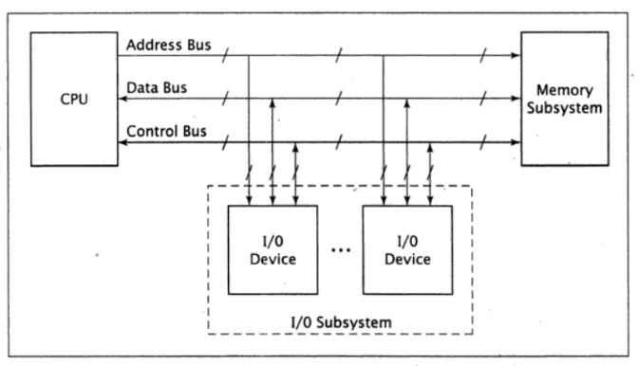
1. Basic Computer Organization
This organization has three main components:
CPU,
memory subsystem, and
IO subsystem

Slide 42
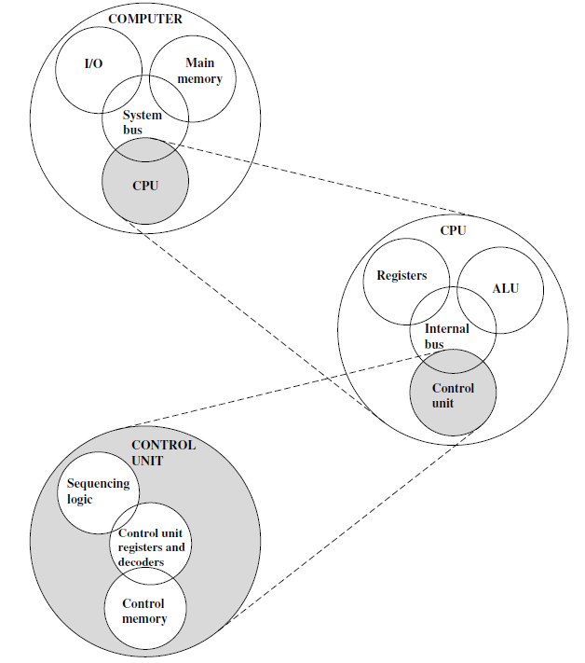
Structural view of Computer System
CPU | Controls the operation of the computer and performs its data processing functions; also referred as processor.
Main Memory | Stores data
I/O | Moves data between the memory and its external environment
System Interconnection | Some mechanism that provides for communication among CPU, main memory and I/O. it is done through system bus.

Slide 43
Structural view of Computer System (Contd.)
Control Unit: | Controls the operation of the CPU and hence the computer.
ALU: | Performs the computer’s data processing function.
Registers: | Provides storage internal to the CPU.
CPU interconnection: | Some mechanisms that provide for communication among the CU, ALU and registers.

Slide 44
Structural view of Computer System (Contd.)
Control Memory: | The registers which store data related to control operation.
Sequential Logic: | Digital circuit whose output depends on current input and state of circuit.
CU register & decoder: | Performs storage and interpretation of the instruction.

Slide 45
2. System Buses
Physically, a bus is a set of wires.
The components of the computer are connected to the buses.
To send information form one component to another, the source component outputs data onto the bus.
The destination component then inputs this data from the bus.
As the complexity of a computer system increases, it becomes more efficient at using buses rather than direct connections between every pair of devices.
Buses use less space on a circuit board and require less power than a large number of direct connections.
They also require fewer pins on the chip or chips that comprise the CPU.

Slide 46
2. System Buses (Contd.)
It is a shared transmission medium. Multiple devices connect to the bus, and a signal transmitted by one device is available for reception by all other devices attached to the bus.
If two devices transmit during the same time period, their signals will overlap and become garbled.
Thus, only one device, at a time, can successfully transmit.
Typically, a bus consists of multiple communication pathways or lines.
Each line is capable of transmitting signals representing binary 1 or 0.
An 8-bit unit of data can be transmitted over eight bus lines.
A bus that connects major computer components (processor, memory, IO) is called a system bus.

Slide 47
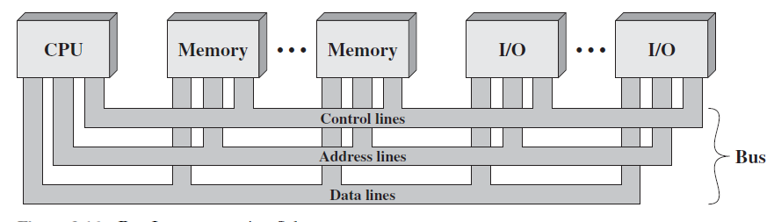
2. System Buses (Contd.)
Data Lines | The data lines provide a path for moving data among system modules. These lines, collectively, are called the data bus.
Address Lines | The address lines are used to designate the source or destination of the data on the data bus.
Control Lines | The control lines are used to control the access to and the use of the data and address lines. Control signals transmit both command and timing information among system modules. Timing signals indicate the validity of data and address information. Command signals specify operation to be performed.

Slide 48
3. Instruction Cycle

Slide 49
3. Instruction Cycle (Contd.)
The instruction cycle is the procedure a microprocessor goes through to process an instruction.
First the microprocessor fetches or reads, the instruction from memory.
Then it decodes the instruction, determining which instruction it has fetched.
Finally, it performs the operations necessary to execute the instruction.
Each of these functions- fetch, decode and execute- consists of a sequence of one or more operations.

Slide 50
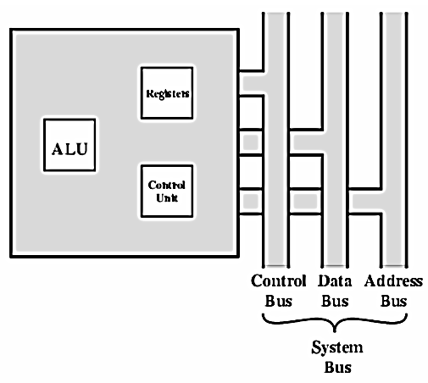
4. CPU organization
CPU consists of three components:
ALU,
CU and
Registers.
ALU performs arithmetic and logical operation,
CU provides control signals, and
Registers store binary information and provide very fast information to ALU and out of CPU.
These components are connected with each other and with external environment through system bus as shown below:

Slide 51
2.4 Memory Sub-system Organization and Interfacing
Memory is the group of circuits used to store data.
Two types of Memory:
RAM
SRAM:
More like registers, no need of refresh
DRAM:
Leaky capacitor, needs refresh
ROM
PROM (Programmable ROM)
EPROM (Erasable PROM)
can be reprogrammed if required by exposing it to ultraviolet light.
EEPROM (Electrically Erasable PROM)
write and erase operations are performed one byte at a time , by application of electrical potential
Flash Memory
Reference: https://www.guru99.com/different-types-ram-random-access-memory.html
https://www.scaler.com/topics/what-is-rom/

Slide 52
RAM Vs ROM
Volatile in nature.
Used for reading and writing data in any order as required.
Data is stored and read many times to and from this type of memory.
Memory cells can be accessed for information transfer from any desired random location.
Read only memory (ROM) contains a permanent pattern of data that cannot be changed.
A ROM is non-volatile, i.e., no power source is required to maintain the bit values in memory.
While it is possible to read a ROM, it is not possible to write new data into it.
The data or program is permanently presented in main memory and never be loaded from a secondary storage device with the advantage of ROM.

Slide 53
Internal Chip Organization
Linear organization
Two-dimensional organization

Slide 54
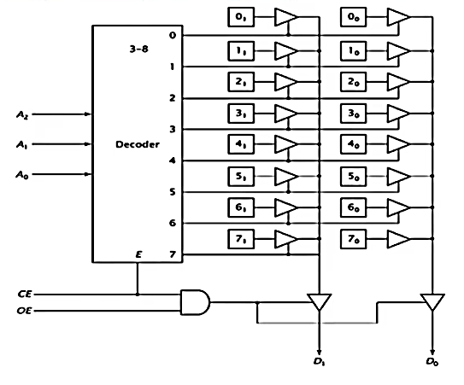
Linear organization
Consider an 8 x 2 ROM chip: (Chip is in 2^{n} x m representation where n is address line and m is data line)
Address line = 3
Data lines = 2
16 bits of internal storage
If CE = 0, decoder is disabled and no location is selected. The Tri-state buffer for that location’s cell are enabled, allowing data to pass to the output buffers.
If CE = 1and OE= 1, tri-state buffer for that location cell is enabled and data is output from the chip; otherwise the outputs are tri-stated.

Slide 55
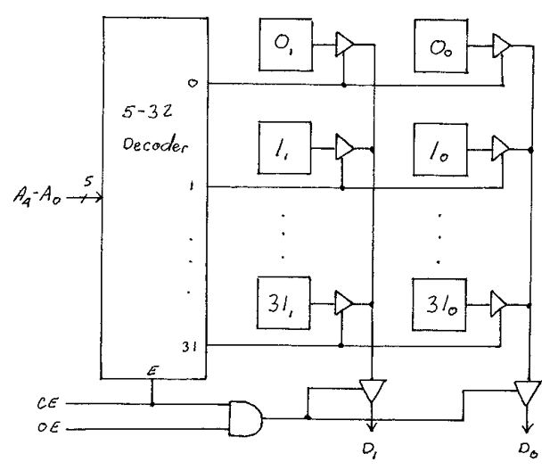
Classwork:
show the internal linear configuration of a 32x2 memory chip.

Slide 56
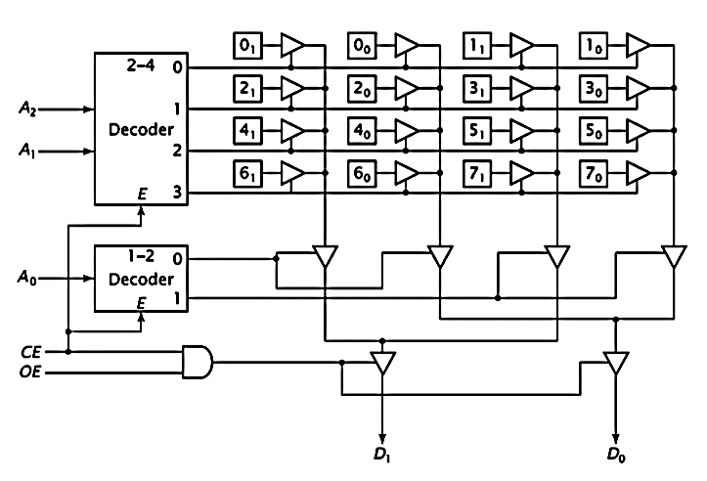
Two-dimensional organization
As the number of locations increases, the size of address decoder needed, becomes extremely large.
To remedy this problem, the memory chip can be designed using multiple dimension of decoding.
This configuration has four rows with four bits per row; each holds two data values.
Here,
A0→ selects one of the 2 locations in a row
A1, A2→ selects one of 4 rows.

Slide 57
2.5 Memory Sub system Configuration
There is technique for joining memory chips to form a memory subsystem.
Two or more chips can be combined to generate a memory with more bits per location.
This is done by linking the corresponding address and control signals of the chips and linking their data pins to various bits of the data bus.

Slide 58
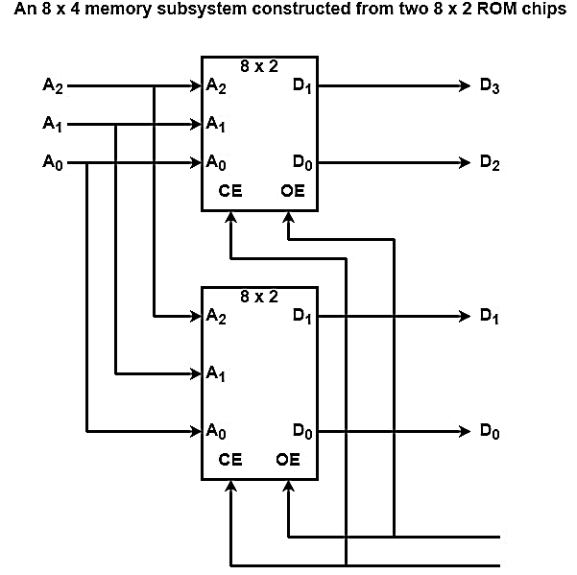
Construction of 8 x 4 ROM from two 8 x 2 ROMs:
Two 8 x 2 chips can be combined to generate an 8 x 4 memory as displayed in the figure.
Both chips get the equal three address inputs from the bus, and the same chip enable (CE) and output enable (OE) signals.
The data chips of the first chips are linked to bits 3 and 2 of the data bus(i.e. D₃ and D₂)
and those of the other chips are linked to bits 1 and 0 (i.e. D₁ and D₀)
When the CPU reads data, it locates the address on the address bus.
Both chips read in address bits A₂, A₁, and A₀ and implement their internal decoding..
If the CE (Chip Enable) and OE (Output Enable) signals are activated, the chips output their data onto the four bits of the data bus.
Because the address and enable signals are equal for both chips, either both chips and neither chip is active at any given time.
The device never has only one of the two, active.
For this reason, they facilitate as only a single 8 x 4 chip at least until the CPU is concerned.

Slide 59
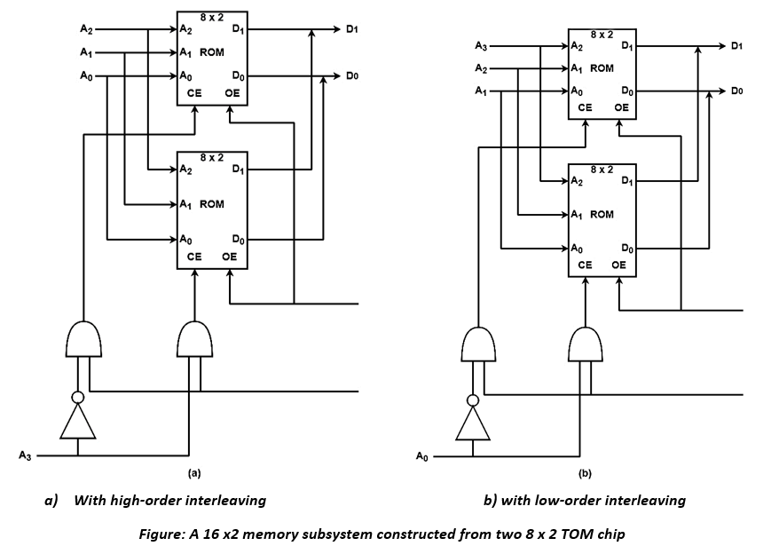
Construction of 16 x 2 ROM from two 8 x2 ROM chip:
Instead of generating wider words, chips can be combined to make more words.
The similar two 8 x 2 chips could alternatively be configured as a 16 x 2 memory subsystem.

Slide 60
i) Using high-order interleaving
The configuration in figure (a) uses high-order interleaving. All memory locations inside a chip are contiguous within system memory.
The upper chip is configured as memory locations 0 to 7 (0000 to 0111) and
the lower chip as locations 8 to 15 (1000 to 1111).
The upper chip always has A₃=0 and the lower chip has A₃=1.
This difference can choose one of the two chips.
When A₃=0, the upper chip is enabled and the lower chip is disabled.
The output enables can be linked, because only the chip that is enabled with output data.
Both chips correspond to similar data bits, both are linked to D₁ and D₀ of the data bus

Slide 61
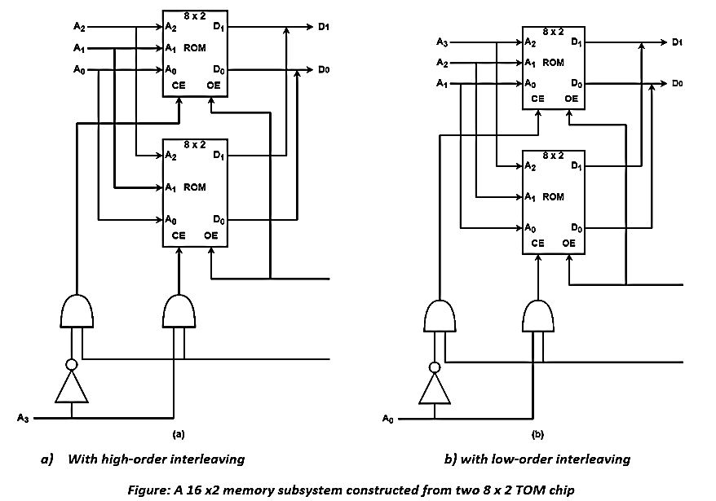
ii) Using low-order interleaving
Consider the configuration displayed in figure (b) which uses low-order interleaving.
The upper chip is enabled when A₀=0, or by addresses XXX0, in this case, 0, 2, 4, 6, 8, 10,12, and 14.
The lower chip is enabled when A₀=1, which is correct for addresses 1, 3, 5, 7, 9, 11, 13, and 15.

Slide 62
Classwork:
Design an 8x4 ROM using 4x4 ROM chips using higher order interleaving. Also explain its operation.
Design a 16x4 memory subsystem with low order interleaving using 8x2 memory chips for a computer system with an 8-bit address bus.
Design a 32x 8 memory subsystem with high-order interleaving using 16x2 memory chips for a computer system with an 8-bit address bus.

Slide 63
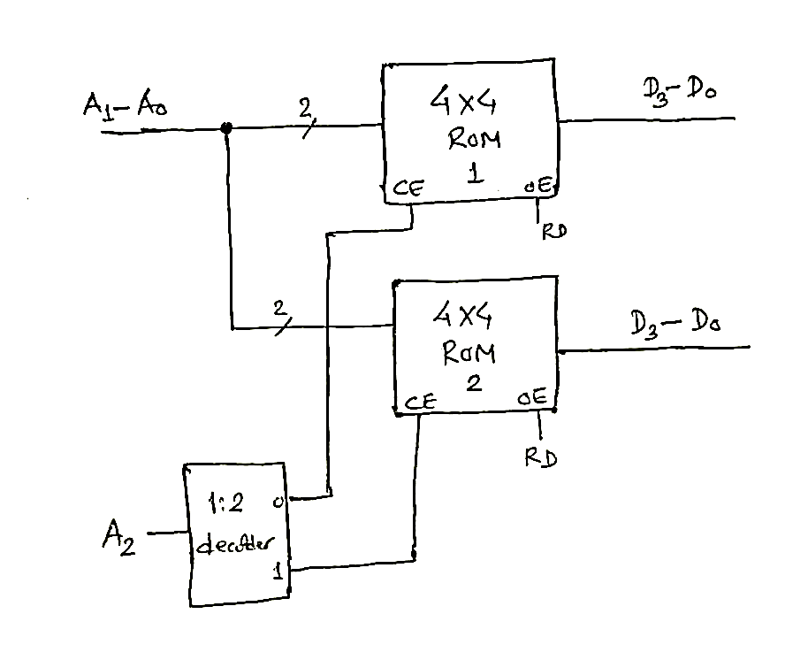

1. Design an 8x4 ROM using 4x4 ROM chips using higher order interleaving. Also explain its operation.
Here:
Available ROM size = 4x4
Required ROM size = 8x4
No. of required ROMs = $\frac{8x4}{4x4}$ = 2
Since, the multiplicand is different, we will have vertical arrangement of ROMs as below:
When A2= 0, the 1:2 decoder outputs form the first line (i.e 0) and thus enables ROM1
When A2= 0, the 1:2 decoder outputs form the second line (i.e 1) and thus enables ROM2.
When address line (A2-A0) is from 000 to 011, the upper ROM1 chip is enabled and the corresponding data (D3-D0) will be out.
When address line (A2-A0) is from 100 to 111, the upper ROM1 chip is enabled and the corresponding data (D3-D0) will be out.

Slide 64
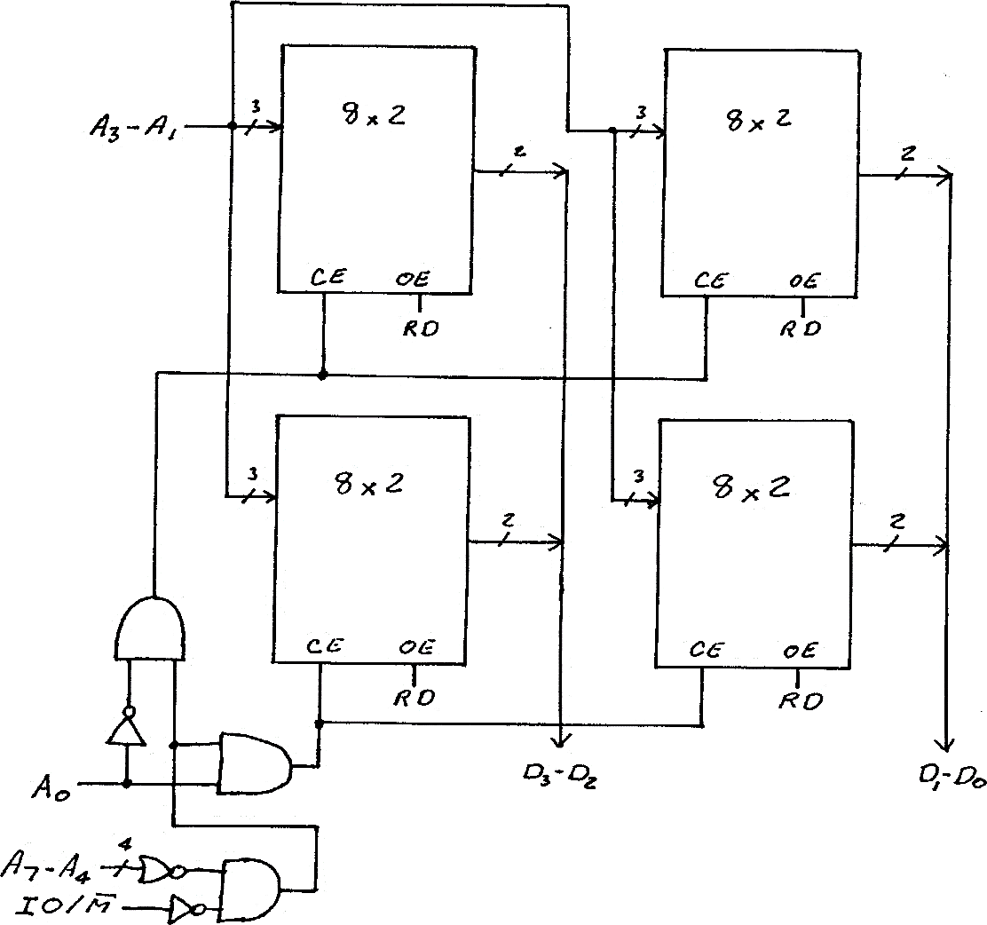
2. Design a 16x4 memory subsystem with low order interleaving using 8x2 memory chips for a computer system with an 8-bit address bus.
Note: Decoder can be used for bit interleaving as in qstn 1

Slide 65
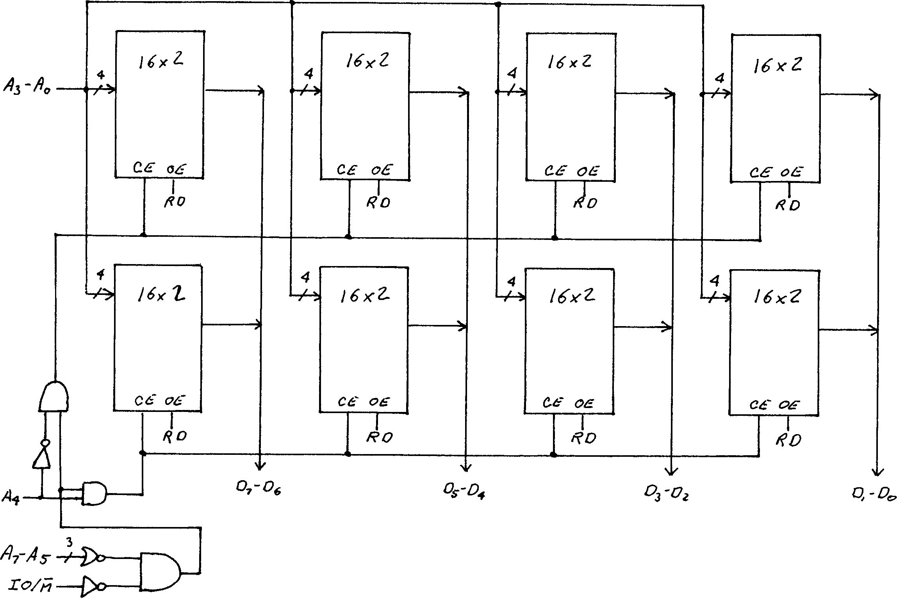
3. Design a 32x 8 memory subsystem with high-order interleaving using 16x2 memory chips for a computer system with an 8-bit address bus.
Note: Decoder can be used for bit interleaving as in qstn 1

Slide 66

6. I/O subsystem Organization and Interfacing
The I/O subsystem is treated as an independent unit in the computer.
The CPU initiates I/O command generally as Read, Write, Scan, etc.
As shown in figure:
The I/O device is connected to the computer system address, data and control buses.
Each I/O device includes I/O circuitry that interacts with the buses.

Slide 67
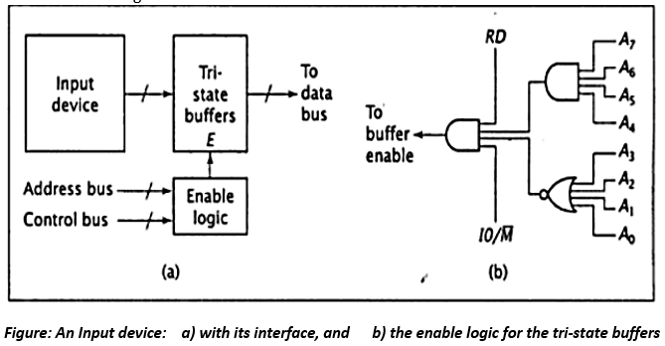
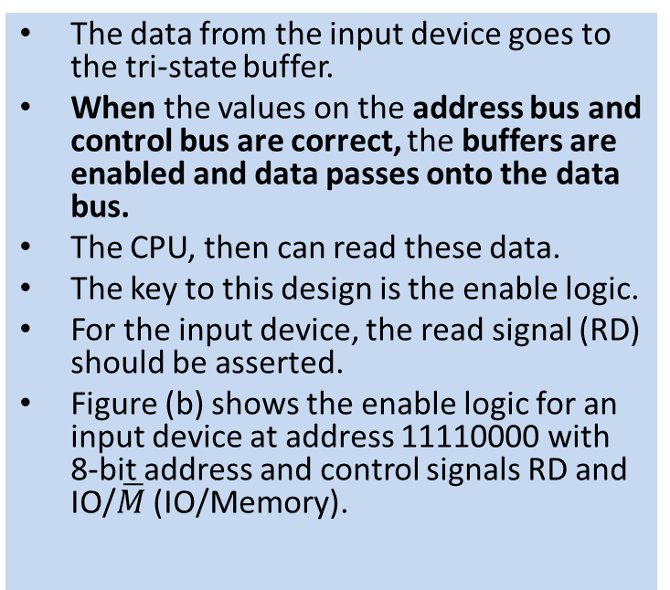
i) Input device
The data from the input device goes to the tri-state buffer.
When the values on the address bus and control bus are correct, the buffers are enabled and data passes onto the data bus.
The CPU, then can read these data.
The key to this design is the enable logic.
For the input device, the read signal (RD) should be asserted.
Figure (b) shows the enable logic for an input device at address 11110000 with 8-bit address and control signals RD and IO/$\overline{M}$ (IO/Memory).

Slide 68
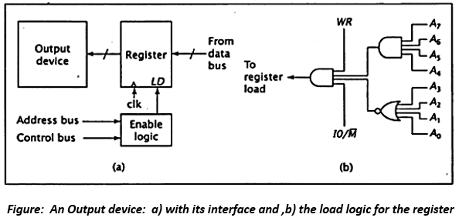
ii) Output Device:
For the interface circuit for an output device, the tri-state buffer is replaced by a register.
Only the device with the correct address will read it in.
The Load logic (LD) plays the role of the enable logic as in the input device.
When this logic receives the correct address and control signals, it asserts the LD signal of the register, causing it to read data from the system’s data bus.
The output device can then read the data from the register at its leisure while the CPU performs other tasks.
The logic to generate the load signal for an output device at address 1111 0000 is shown in figure (b).

Slide 69
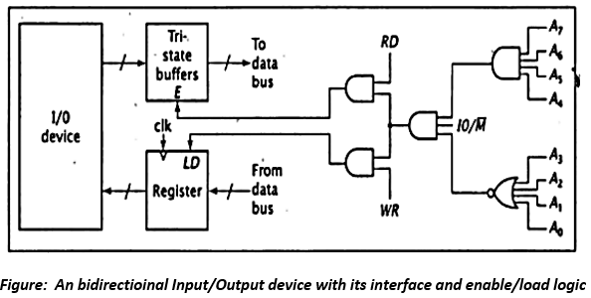
iii) Bidirectional IO device
Some devices are used for both input and output. A personal computer’s hard disk drive falls into this category.
Such a device requires a combined interface that is essentially two interfaces, one for input and the other for output.
Some logic elements, such as the gates that check the address and the address bus, can be used to generate both the buffer enable and register load signals.
Figure below shows a combined I/O interface for address 1111 0000.

Slide 70
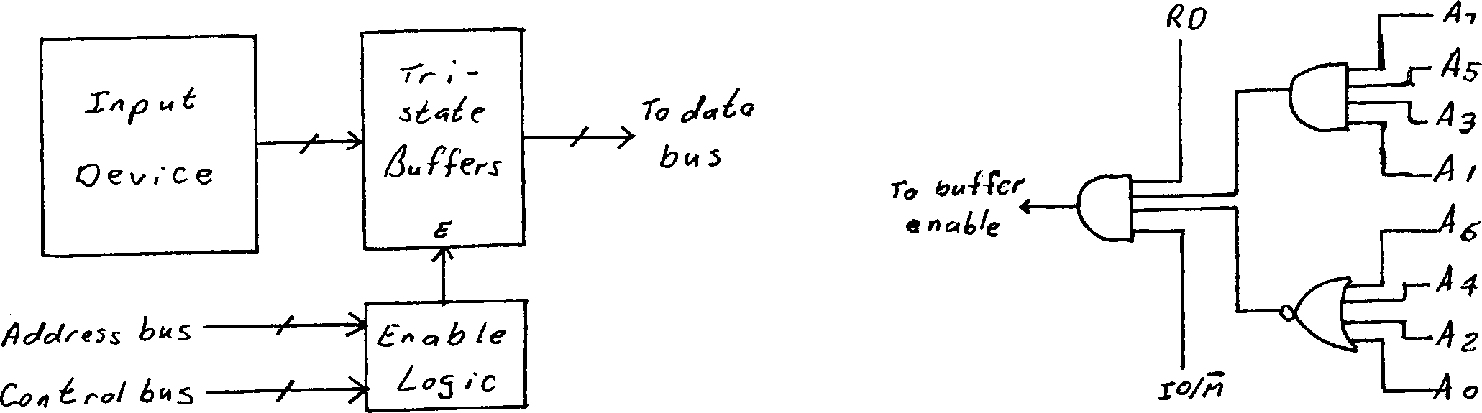
1. Design an interface for an input device which has binary address 1010 1010. Its computer system uses isolated I/0.

Slide 71
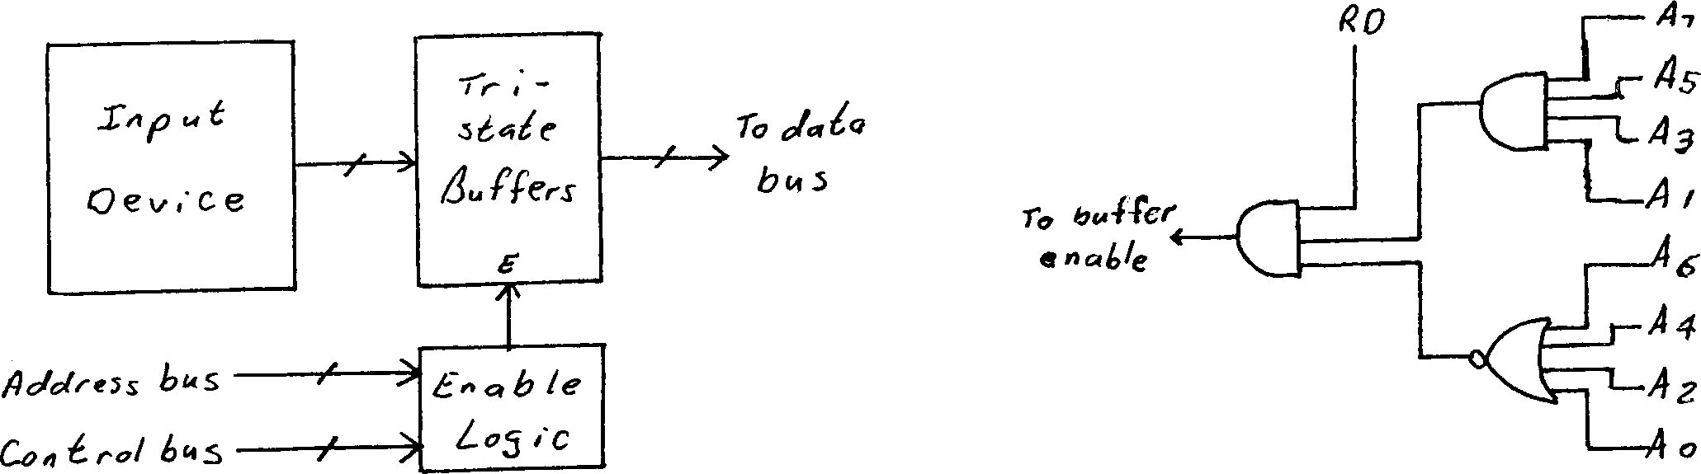
2. Design an interface for an input device which has binary address 1010 1010. Its computer system uses memory mapped I/O.

Slide 72
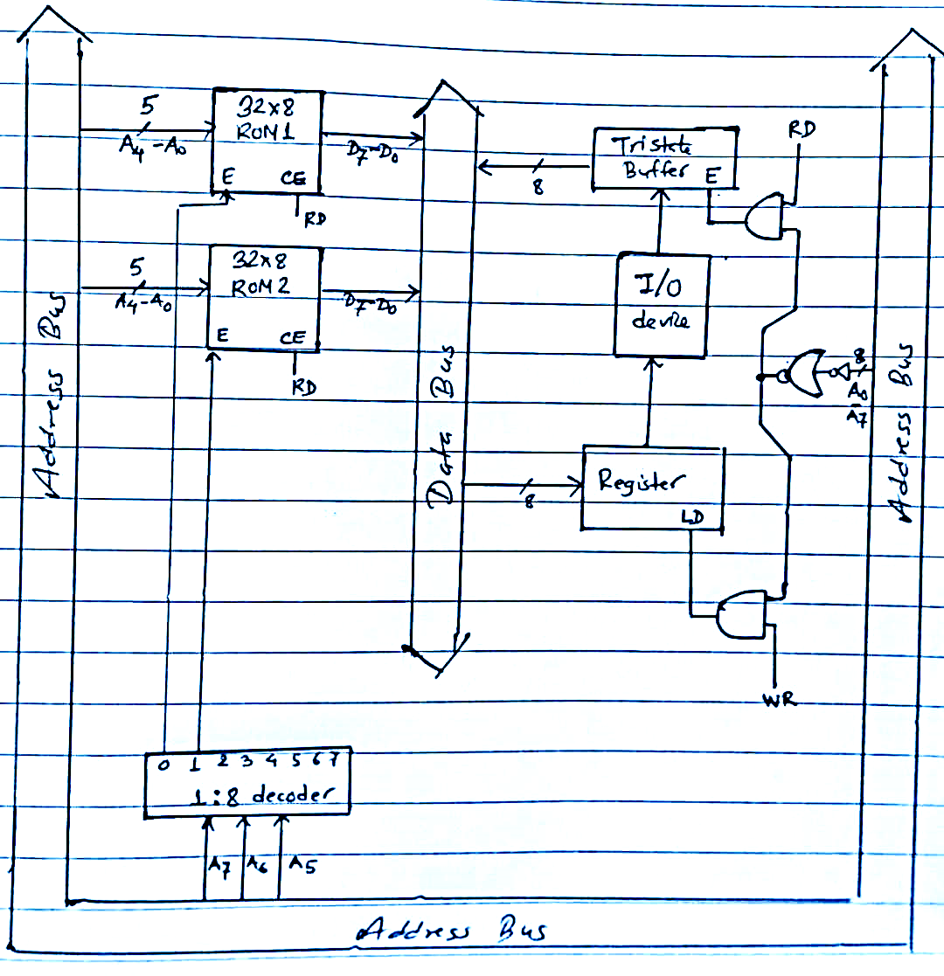
6. A CPU with 8-bit data bus and 8-bit address bus uses memory mapped I/O. It has 32 byte of ROM at 00H and 32 byte of ROM at 20H. It also has an I/O device at FFH. Show the load logic and enable logic.
Here:
Data bus width = 8 bits (D7-D0)
Address bus width = 8 bits (A7-A0)
ROM1 size= 32x8 starting at 00H (5 Address lines: A4-A0)
ROM2 size= 32x8 starting at 20H (5 Address lines: A4-A0)
I/O device starting at FFH
Memory | HexCode | A7 | A6 | A5 | A4 | A3 | A2 | A1 | A0
ROM1 | 00H | 0 | 0 | 0 | 0 | 0 | 0 | 0 | 0
 | 1FH | 0 | 0 | 0 | 1 | 1 | 1 | 1 | 1
ROM2 | 20H | 0 | 0 | 1 | 0 | 0 | 0 | 0 | 0
 | 3FH | 0 | 0 | 1 | 1 | 1 | 1 | 1 | 1
IO | FFH | 1 | 1 | 1 | 1 | 1 | 1 | 1 | 1

Slide 73
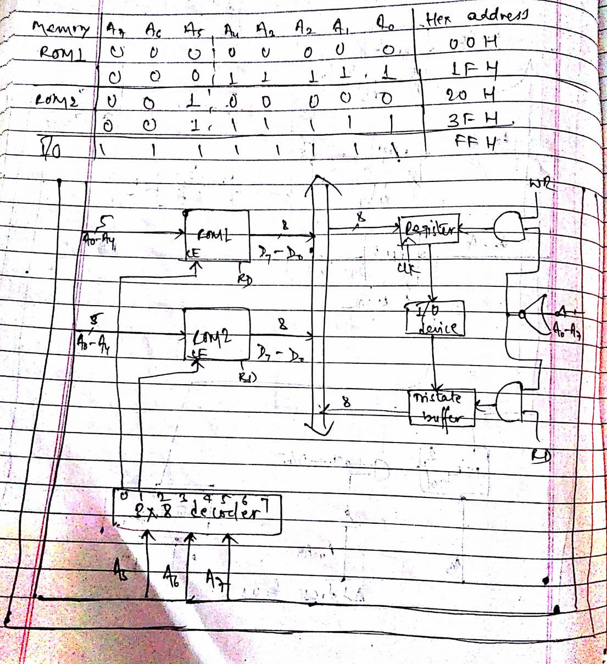
6. A CPU with 8-bit data bus and 8-bit address bus uses memory mapped I/O. It has 32 byte of ROM at 00H and 32 byte of ROM at 20H. It also has an I/O device at FFH. Show the load logic and enable logic.
Here:
Data bus width = 8 bits (D7-D0)
Address bus width = 8 bits (A7-A0)
ROM1 size= 32x8 starting at 00H
ROM2 size= 32x8 starting at 20H
I/O device starting at FFH
Memory | HexCode | A7 | A6 | A5 | A4 | A3 | A2 | A1 | A0
ROM1 | 00H | 0 | 0 | 0 | 0 | 0 | 0 | 0 | 0
 | 1FH | 0 | 0 | 0 | 1 | 1 | 1 | 1 | 1
ROM2 | 20H | 0 | 0 | 1 | 0 | 0 | 0 | 0 | 0
 | 3FH | 0 | 0 | 1 | 1 | 1 | 1 | 1 | 1
IO | FFH | 1 | 1 | 1 | 1 | 1 | 1 | 1 | 1

Slide 74
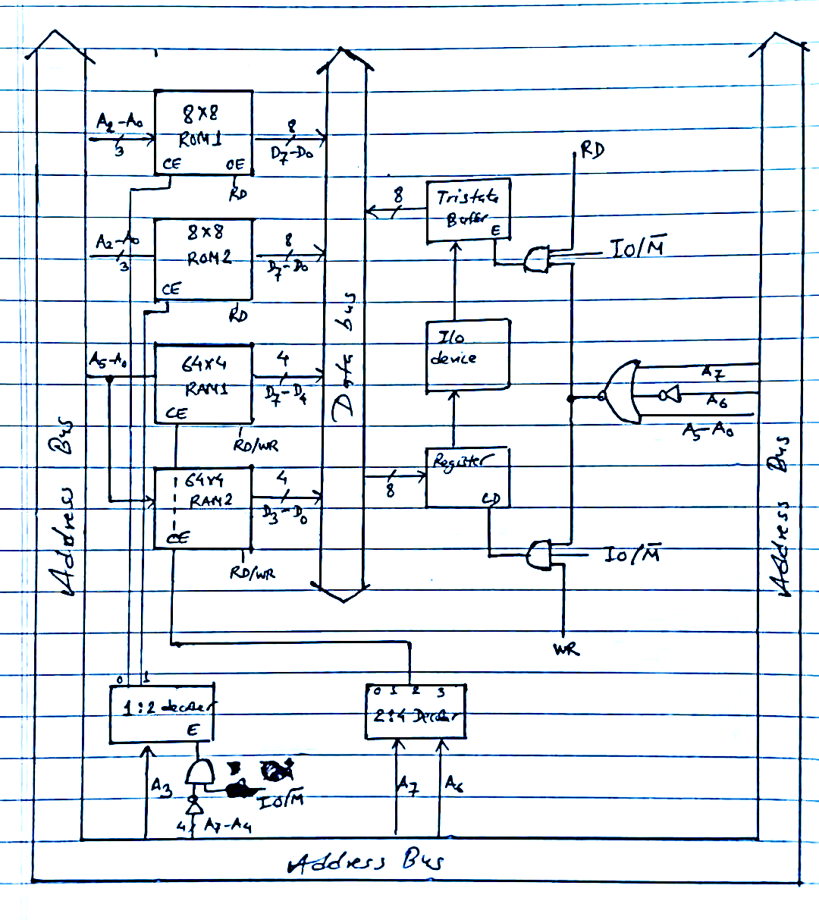
7. A computer system with an 8-bit address and an 8-bit data bus using isolated I/O. It has 16 x 8 ROM starting at address 00H constructed using 8 x8 chips; 64 x 8 of RAM starting at address 80H constructed using 64 x 4 chips. There is an I/O device at 40H. Show the design for the system.
Here:
Data bus width = 8 bits (D7-D0)
Address bus width = 8 bits (A7-A0)
ROM1 size= 8x8 starting at 00H (Address lines: A2-A0)
ROM2 size= 8x8
RAM1 size= 64x4 starting at 80H (Address lines: A5-A0)
RAM2 size= 64x4
I/O device starting at 40H
Memory | HexCode | A7 | A6 | A5 | A4 | A3 | A2 | A1 | A0
ROM1 | 00H | 0 | 0 | 0 | 0 | 0 | 0 | 0 | 0
 | 07H | 0 | 0 | 0 | 0 | 0 | 1 | 1 | 1
ROM2 | 08H | 0 | 0 | 0 | 0 | 1 | 0 | 0 | 0
 | 0FH | 0 | 0 | 0 | 0 | 1 | 1 | 1 | 1
RAM1 and RAM2 | 80H | 1 | 0 | 0 | 0 | 0 | 0 | 0 | 0
 | BFH | 1 | 0 | 1 | 1 | 1 | 1 | 1 | 1
IO | 40H | 0 | 1 | 0 | 0 | 0 | 0 | 0 | 0

Slide 75
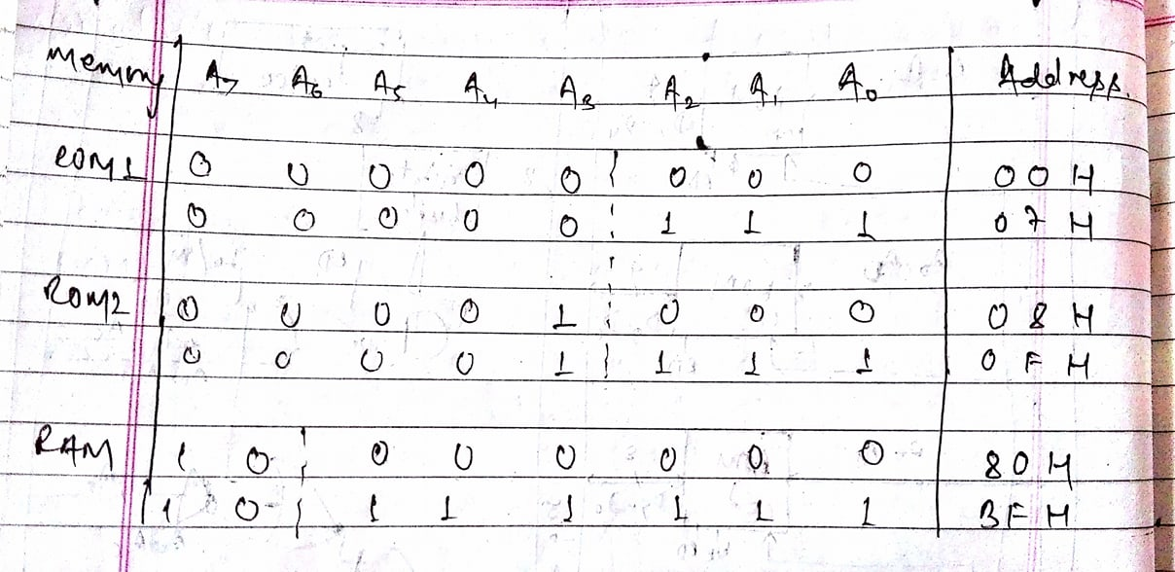
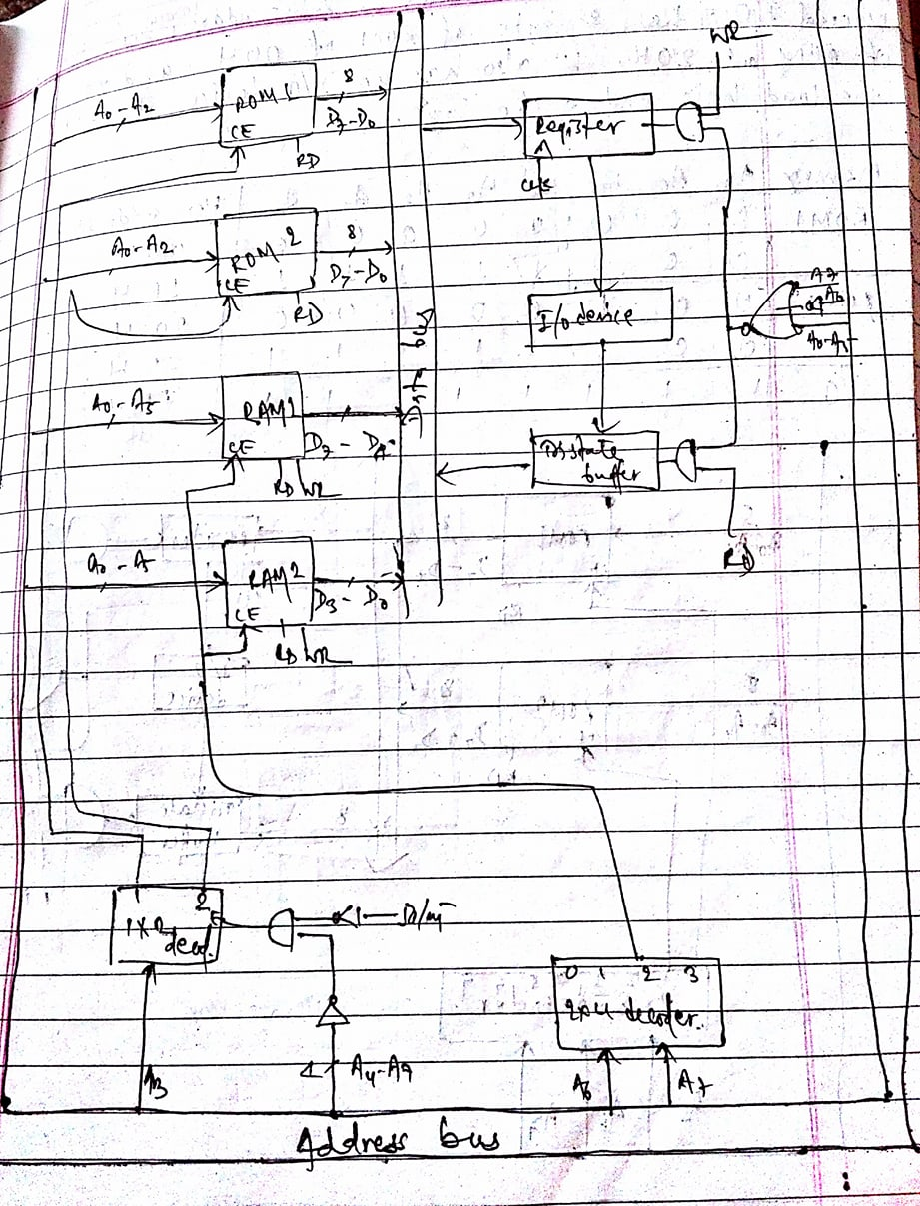

Slide 76
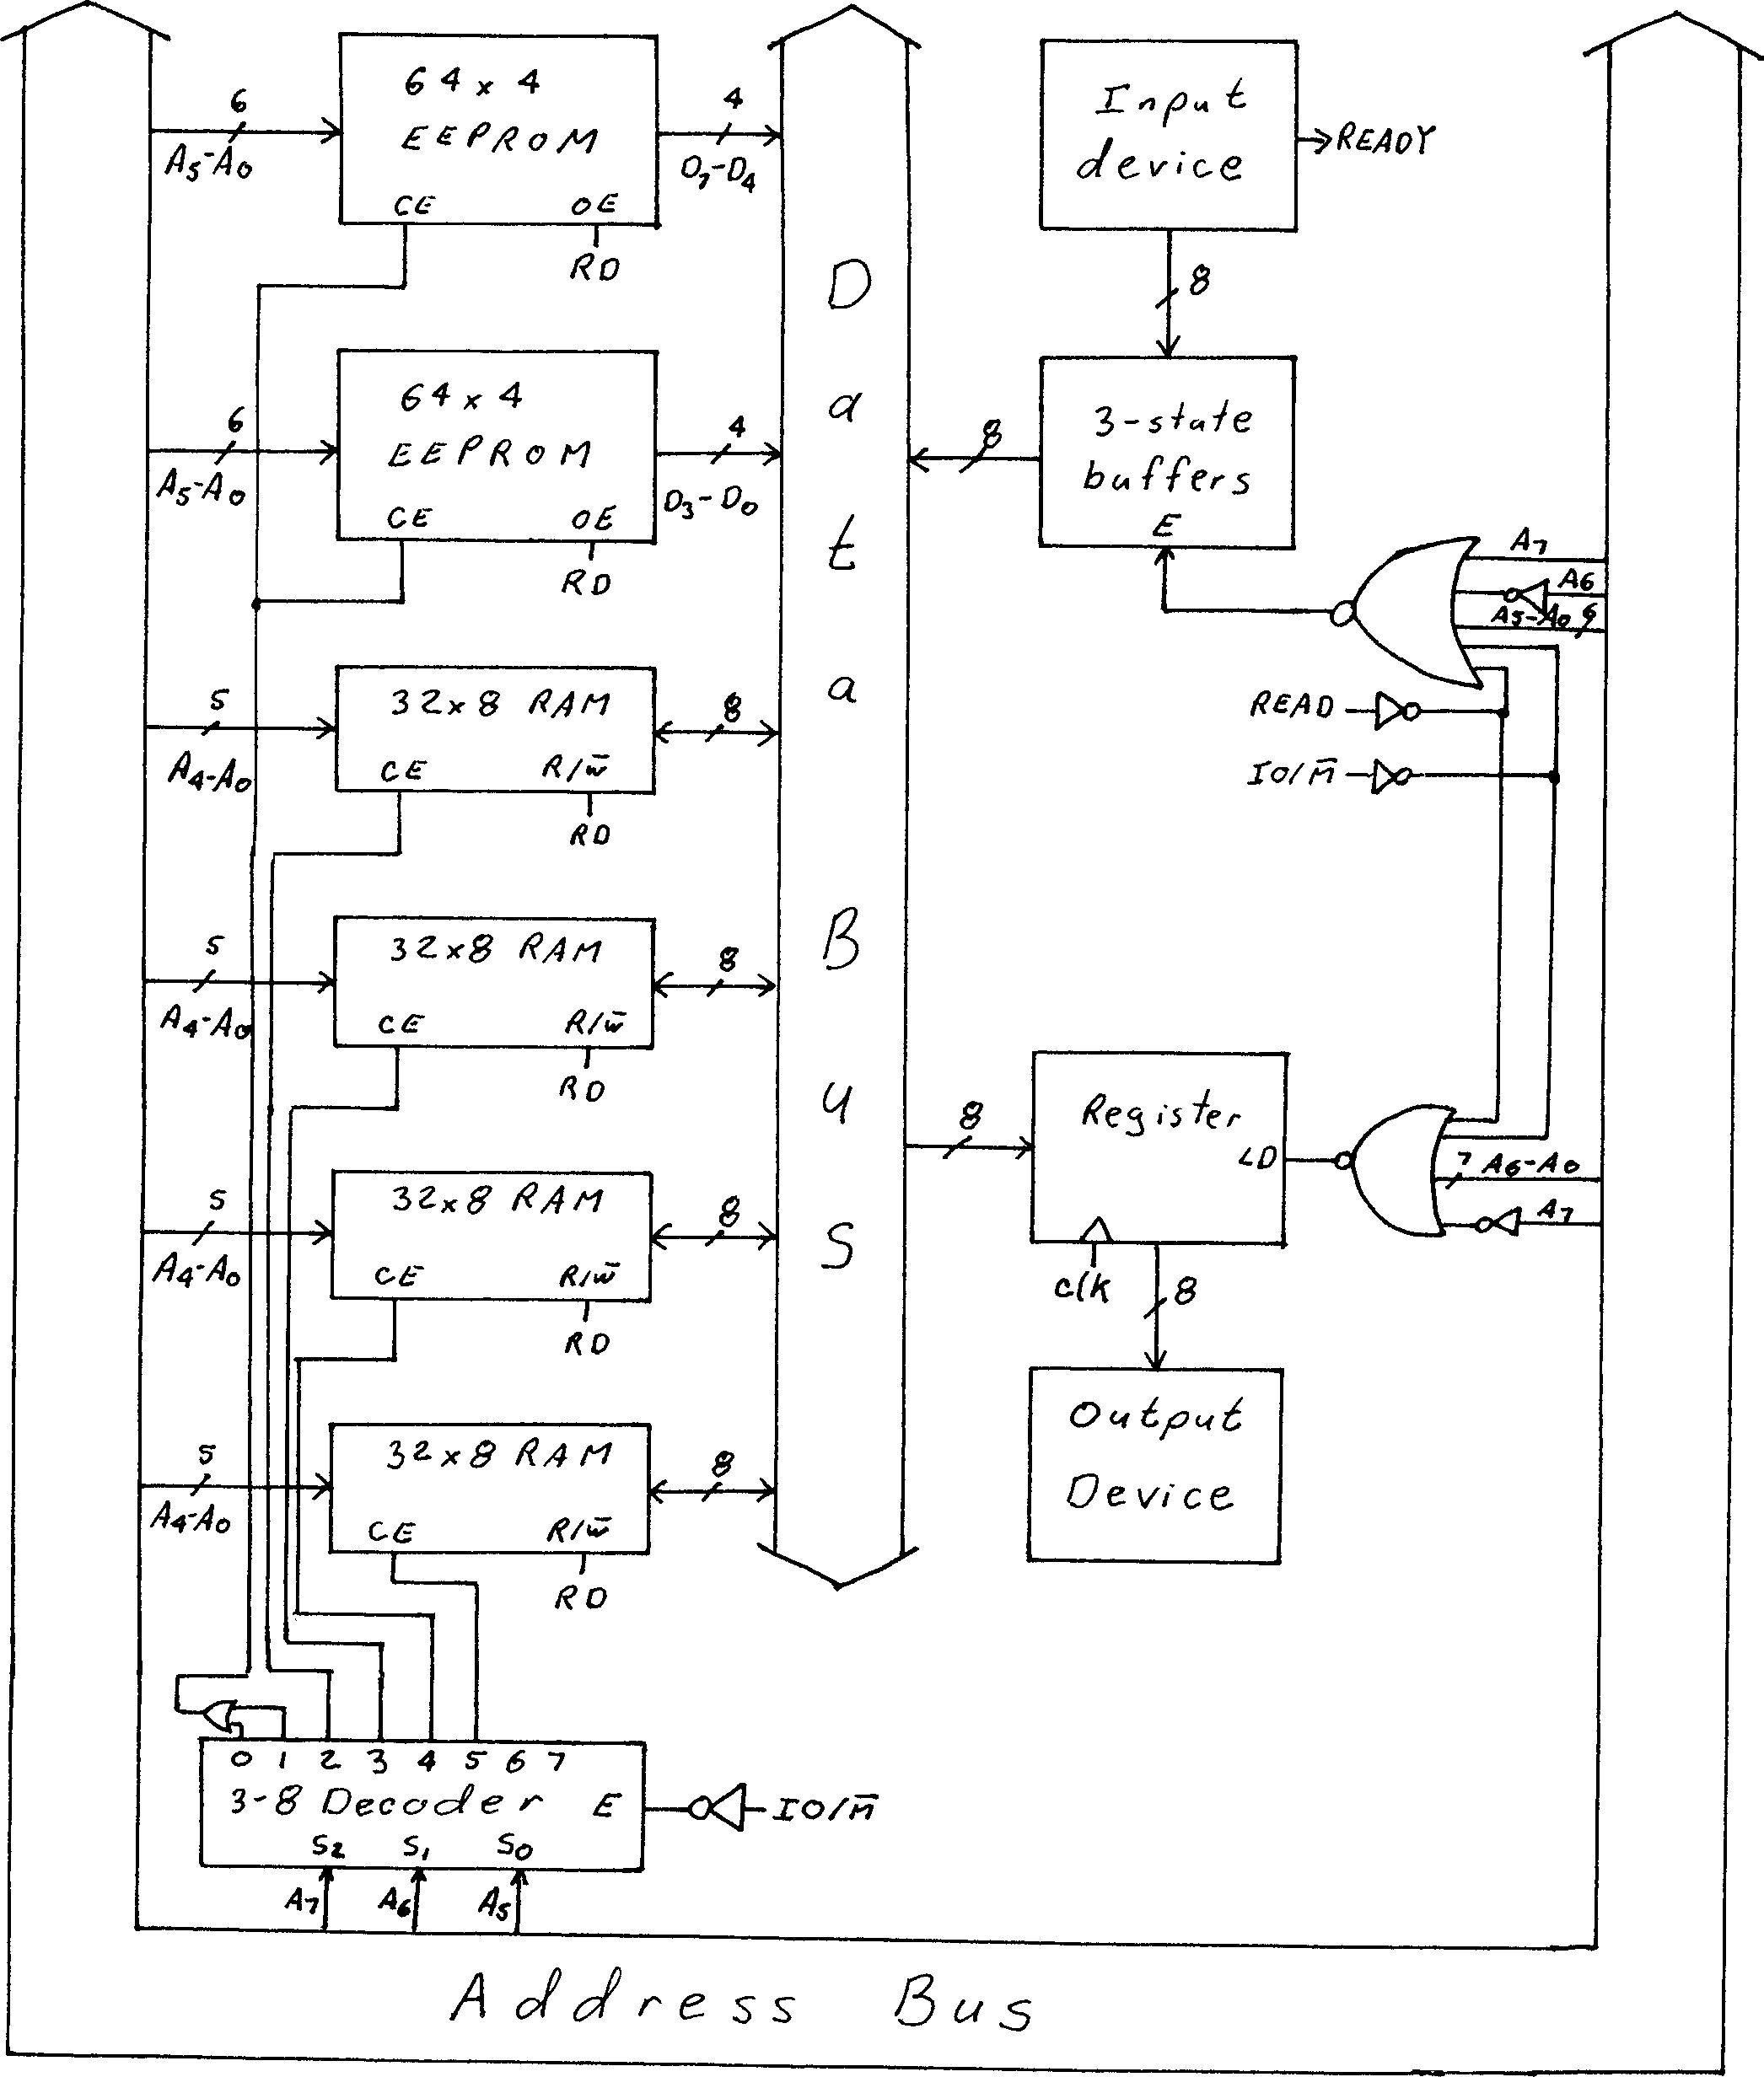
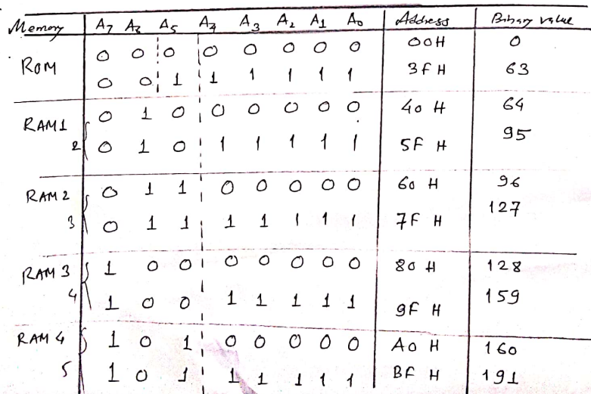
8. A computer system with 8-bit data bus and 8-bit control bus uses isolated I/O. It has 64 bytes of ROM starting at 00H constructed using 64 x 4 chips; 128 bytes of RAM, starting at address 40H constructed using 32 x 8 chips; an input device with READY signal at address 40H; and an output with no READY signal at address 80H. Show the design for this system. Include all enable and load logic.
Here:
Data bus width = 8 bits (D7-D0)
Address bus width = 8 bits (A7-A0)
ROM size= 64x8 starting at 00H (5 Address lines: A4-A0)
We require two 64x4 ROMs for its construction
RAM size= 128x8 starting at 40H (6 Address lines: A5-A0)
We require five 32x8 chips for its construction
Input device with READY signal at 40H
Output device with no READY signal at 80H
40H=
0100 0000
Decimal Value
80H=
1000 0000
1 and 2
76

Slide 77
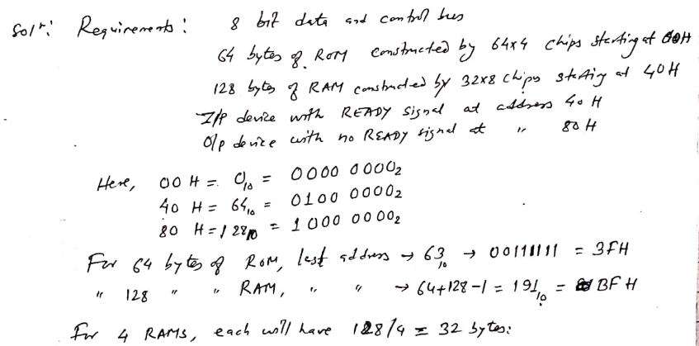
40H=
0100 0000
Decimal Value
80H=
1000 0000
77

Slide 78
Exercise:
Differentiate between Microprocessor and Microcontroller.
Differentiate between Von-Neumann and Harvard Architecture with suitable block diagrams.
Explain the phases in instruction cycle.
What are the applications of Microprocessor? Briefly explain.
What are the applications of Microcontroller? Briefly explain.
Explain the basic computer organization.
Explain the linear organization of 8x2 ROM chip.
Explain the horizontal organization of 8x2 ROM chip.

Slide 79
Construct an 8x4 ROM from two 8x2 ROMs. Also explain it.
Construct an 8x4 ROM from two 8x2 ROMs using high-order interleaving. Also explain it.
Construct an 8x4 ROM from two 8x2 ROMs using low-order interleaving. Also explain it.
Design a 16x4 memory subsystem with high order interleaving using 8x2 memory chips for a computer system with an 8-bit address bus.
Design a 16x4 memory subsystem with low order interleaving using 8x2 memory chips for a computer system with an 8-bit address bus.
Design an interface for an input device which has binary address 1010 1010. Its computer system uses isolated I/0.
Design an interface for an input device which has binary address 1010 1010. Its computer system uses memory mapped I/O.
Design an interface for a bidirectional Input/output device that has binary address 1000 0001. Its computer system uses Isolated I/O.

Slide 80
A CPU with 8-bit data bus and 8-bit address bus uses memory mapped I/O. It has 32 byte of ROM at 00H and 32 byte of ROM at 20H. It also has an I/O device at FFH. Show the load logic and enable logic.
A computer system with an 8-bit address and an 8-bit data bus using isolated I/O. It has 16 x 8 ROM starting at address 00H constructed using 8 x8 chips; 64 x 8 of RAM starting at address 80H constructed using 64 x 4 chips. There is an I/O device at 40H. Show the design for the system.
8. A computer system with 8-bit data bus and 8-bit control bus uses isolated I/O. It has 64 bytes of ROM starting at 00H constructed using 64 x 4 chips; 128 bytes of RAM, starting at address 40H constructed using 32 x 8 chips; an input device with READY signal at address 40H; and an output with no READY signal at address 80H. Show the design for this system. Include all enable and load logic.
A computer has a CPU with 8-bit address bus and 16-bit data bus. The computer uses Isolated I/O. It has 64 x 16 of ROM at 00 H; constructed using two 32 x 16 ROM chips. It also has 32 x16 of RAM at C0 H. The system has an input device at 17 H and an output device at B5 H. Show the design for the system including all the required logic. [PU 2018 Fall]
A computer system with an 8-bit address bus and an 8-bit data bus uses memory-mapped I/O. It has 32 bytes of ROM starting at address 00H constructed using a single 32x8 chip; 128 bytes of RAM starting at address 80H constructed using 64x4 chips; a bidirectional I/O device with no READY signal at address 40H; and an input device with no READY signal at address 60H. Show the design for this system. Include all enable and load logic.

Slide 81
End of Chapter

